Slide 1
Beginning to Write with Beginners
Presenter:
Bilingual Department
Nereyda Ledezma

Slide 2
The only way students are going to improve at writing ideas and conventions is to actually write.

Slide 3
ELL’s & Writing
There is a very important correlation between writing and language development. As students develop language skills, they often develop listening skills first (lots of input they can understand), then speaking (they begin to formulate their ideas in the second language), then reading (they can understand the sound/symbol correspondence of the new language and make sense of the words) and finally writing (they have enough language to express their own ideas in writing).

Slide 4
Not all Writing-to-Learn Activities Need to be Graded
Teachers should offer feedback and comments but should not feel compelled to grade the spelling, grammar, organization, and content of these writing activities
The purpose is to promote active learning, encourage discussion, engage all students, and encourage thinking
Most writing in classrooms does not need to be heavily graded, so the teacher’s workload is decreased

Slide 5
Monday Fun Day MAD LIBS

Slide 6
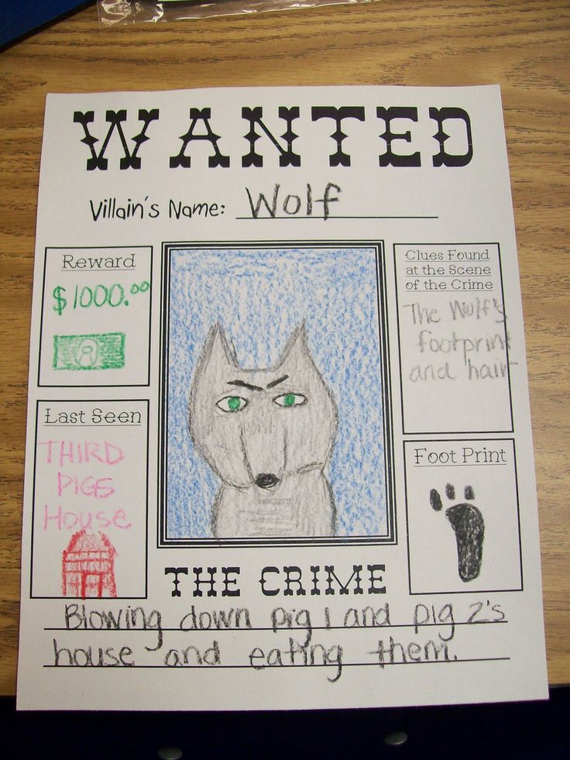
WANT ADS
Students can create want ads to show their understanding of literary characters or historical figures by composing want ads that depict something the person seeks, wants to sell, or could offer as a service.

Slide 7
Acrostic Poems
An acrostic is a poem that is formed by
writing a word down a page and using the letters in
the word to begin each line of a poem. For example,
the following sample acrostic from a science class:
Blood brings oxygen
Records memories
Always working
Imagining plans
Neurons tell the body what to do

Slide 8
A B C P O E T R Y

Slide 9
Book Poem
Rubric
Must be 3 complete sentences or longer
Must follow the same topic in all sentences
Must make words easy to follow on the page for the reader (need to have a flow)

Slide 10
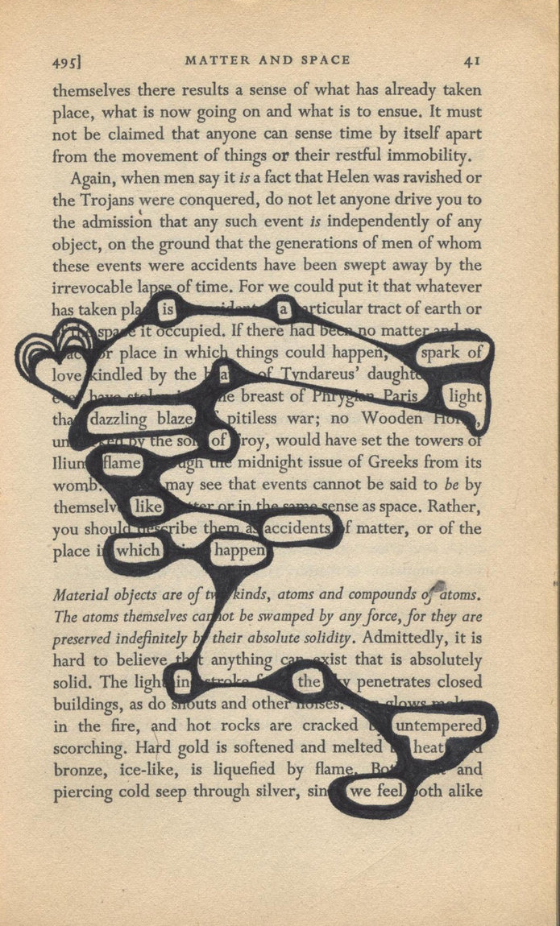
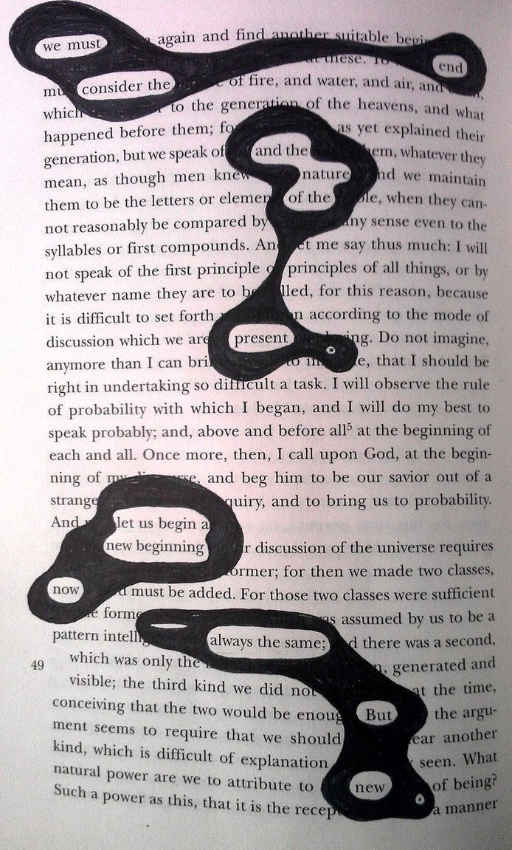

Slide 11
Geo Poem – History (Culture)
A novice ESL student in social studies who feels apprehensive about writing an autobiographical paragraph at the beginning of the year during a “getting to know you activity” writes a structured “Geo Poem” (Bachman-Williams, 2001) about his or her country of origin to gain confidence and pre-write about his or her culture before moving to the paragraph assignment.
The format is as follows:
Geo Poem
(Name of country)
(Four adjectives – words or statements that
describe the country)
Home of… (something that distinguishes
it from other countries)
Neighbor of… (name at least three
neighboring countries)
Who exports… (three items)
Who imports… (three items)
Who is proud of… (people, places, or
characteristics)
Who celebrates… (name three holidays)
Whose flag is… (name the colors in the flag)
Member of… (continent on which it is found)
(Local name of country and a phrase to
describe the origin of the name)

Slide 12
Anticipation Guides to Promote Writing
An anticipation guide (Burke, 1999) consists of a list of statements about a topic that bring to light differences of opinion. Statements such as the following tend to promote thinking and discussion:

Slide 13
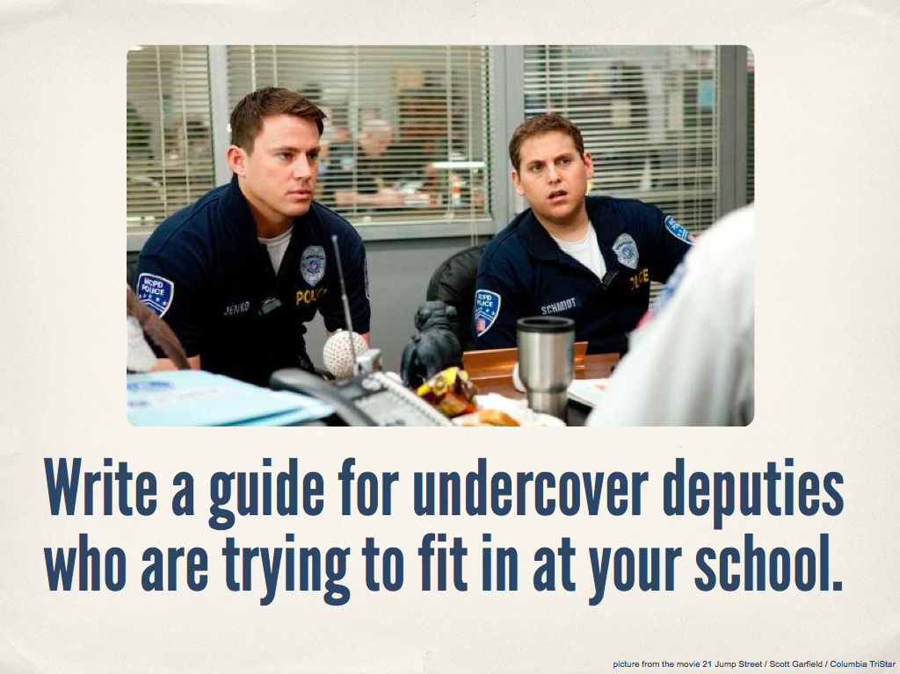

Slide 20
http://writingprompts.tumblr.com/

Slide 21
Thank you!

