Slide 1
A CONDUIT TO THE IMAGINATION
Based on Don and Jenny Killagon’s Grammar for College Writing
http://studyguides.heinemann.com/grammar-for-college-writing-instructors-manual

Slide 2
Portia Belmont
Proud Lopez Lobo
AP and Dual Enrollment Teacher
Attended the AP Institute at Oxford University in England, Summer 2015
http://www.apoxfordacademy.org/index.html

Slide 3
§110.31. English Language Arts and Reading, English I (One Credit), Beginning with School Year 2009-2010.
(17) Oral and Written Conventions/Conventions. Students understand the function of and use the conventions of academic language when speaking and writing. Students will continue to apply earlier standards with greater complexity. Students are expected to:
(A) use and understand the function of the following parts of speech in the context of reading, writing, and speaking:
(i) more complex active and passive tenses and verbals (gerunds, infinitives, participles);
(ii) restrictive and nonrestrictive relative clauses; and
(iii) reciprocal pronouns (e.g., each other, one another);
(B) identify and use the subjunctive mood to express doubts, wishes, and possibilities; and
(C) use a variety of correctly structured sentences (e.g., compound, complex, compound-complex).

Slide 4
110.34. English Language Arts and Reading, English IV (One Credit), Beginning with School Year 2009-2010
17) Oral and Written Conventions/Conventions. Students understand the function of and use the conventions of academic language when speaking and writing. Students will continue to apply earlier standards with greater complexity. Students are expected to:
(A) use and understand the function of different types of clauses and phrases (e.g., adjectival, noun, adverbial clauses and phrases); and
(B) use a variety of correctly structured sentences (e.g., compound, complex, compound-complex).

Slide 5
Comprehensive Purpose Question CPQ
How will imitating master writers improve my writing and reading ability? (student)
How will I incorporate (tweak) what I have learned today into my own lessons? (teacher)

Slide 6
Syntax
Definition-the choice and arrangement of words, phrases, and clauses to create sentences.

Slide 7
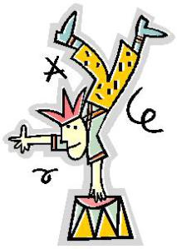
Sentence composing provides acrobatic training in sentence dexterity.
6 Sentence Composing Techniques
Matching
Unscrambling
Combining
Imitating
Exchanging
Expanding

Slide 8
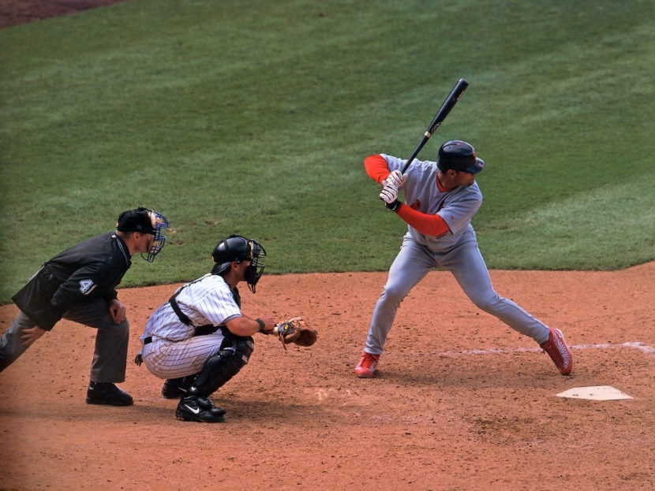
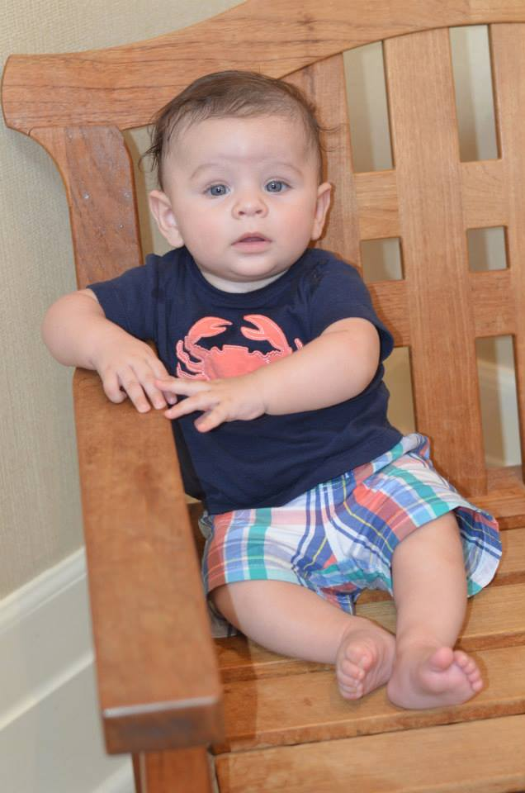
We learn by imitation: Imitation is, in short, a conduit to originality, a link to creation.

Slide 9
“Whenever we read a sentence and like it, we unconsciously store it away in our model-chamber; and it goes with the myriad of its fellows, to the building, brick by brick, of the eventual edifice which we call our style.” —Mark Twain, from a letter to George Bainton

Slide 10
EXAMPLE: Write a sentence like this model.
Model Sentence:
On stormy nights, when the tide was out, the Bay of Fougere, fifty feet below the house, resembled an immense black pit, from which arose mutterings and sighs as if the sands down there had been alive and complaining.
Joseph Conrad, “The Idiots”
-----------------------------------------------------------------
Result:
During rush-hour traffic, when his nerves were frazzled, Brent Hammond, twenty miles above the speed limit, hit his brakes, from which came sharp peals and leaden grindings as though the metal were alive and hurting.

Slide 11
Beyond Primer Prose: Two Ways to Imitate the Masters By: Romana Hillebrand Publication: The Quarterly, Vol. 26, No. 2 Date: 2004
http://www.nwp.org/cs/public/print/resource/1792

Slide 12
PRACTICE 1: MATCHING Given a list of sentences, and a list of tools excerpted from those sentences, students match the tool with the sentence. Placed first in the sequence of practices, it reinforces students’ new understanding of the characteristics of the particular tool.
Purpose: to introduce the new tool by seeing many examples, and then inserting each tool logically into the appropriate position.

Slide 13
Appositive –from the Latin Ponere- to place it beside.
An appositive phrase adds meaning to a noun.

Slide 14
Sentences: | Appositive Phrases:
1. There was no one in the Hot Spot store but Mr. Shiflet and the boy behind the counter, ^. Flannery O’Connor, “The Life You Save May Be Your Own” | a. A tasteless, colorless substance that clings to the stomach lining with the avidity of Krazy Glue
2. I consider my own breakfast cereal, ^. Barbara Ehrenrich, The Startling Citizen | b. The young man who worked as Mr. Hosokawa’s translator
3. In our clenched fists, we held our working cards from the shop, ^. Gerda Weissmann Klein, “All but My Life” | c. Its shadow
4. Watanbe, ^, leaned over and spoke the words in Japanese to his employer. Ann Patchett, Bel Canto | d. Those sacred cards we thought meant security
5. A gray cat, dragging its belly, crept across the lawn, and a black one, ^, trailed after. Katherine Mansfield, “Bliss” | e. A pale youth with a greasy rag hung over his shoulder

Slide 15
Matching Suggestions
■ Tell students before they attempt the matching to read through all the sentences in the left column and all the examples of the tools in the right column to start a process of elimination and make logical connections.
■ After (or before) the matching, have students cover the left column (sentences) and compose original sentences into which they insert the sentence parts from the right column. A variation: Cover the right column (tools) and compose original sentence parts to insert into the sentences in the left column. The sentence parts should be in the form of the current focus tool: for example, appositive phrase.
■ Review the places where the tool can occur in a sentence by locating the carets in each of the sentences in the left column. Use these terms to describe the possible positions: opener, S-V split, closer.
■ From a novel the class studies, have students locate five sentences that illustrate the focus tool and underline it.
■ Using their located sentences, have students in partners construct matching exercises like the ones in the worktext, then exchange them with other partnerships to do the matching.

Slide 16
Unscrambling
PRACTICE 2: UNSCRAMBLING A model sentence is presented, then a scrambled imitation of that model. Students rearrange the scrambled list of sentence parts to match the structure of the model, write an imitation of the model, and identify the focus tool in the model and their imitations. Students see the correspondence between like sentence parts in the model and the scrambled list.
Purpose: to break down the imitation task into manageable steps by isolating the sentence parts of the model.

Slide 17
MODEL:
The proprietor, a little gray man with an unkempt mustache and watery eyes, leaned on the counter, reading a newspaper.
John Steinbeck, The Grapes of Wrath
a tall thin blonde
walked down the runway
with a long mane and long legs
the model
eyeing the audience

Slide 18
Scrambling Suggestions:
■ To help students see the correspondence between the sentence parts in the model and those in the scrambled list, have students, before they unscramble the parts, go through the model, one sentence part at a time, and locate the equivalent sentence part in the scrambled list.
■ Once students have successfully unscrambled the list to produce an imitation of the model sentence, have them write their own imitations, one sentence part at a time.
■ A variation: Limit all students to imitating the parts in segments: just the first sentence part (and then go around the class to hear results), then the second sentence part (and then hear the results from everyone), and so on. This process reinforces understanding of the sentence parts of the model and facilitates imitating

Slide 19
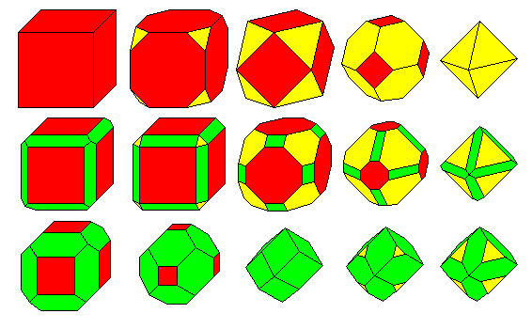
PRACTICE 3: COMBINING
A model sentence is presented, then a list of short sentences for students to combine into one sentence that imitates the model. They then write an imitation of the model, and identify the focus tool in the model and their imitations. Students need to transform the short sentences into the equivalent sentence parts of the model being imitated.
Purpose: to convert sentences into sentence parts equivalent to those in the model and thereby imitate the structure of the model.

Slide 20
Combining is more challenging than unscrambling because students are not given the form of the desired sentence parts. Instead, they must convert the sentences into the form of those desired sentence parts.
MODEL:
A veteran bronc rider, Tom Black has ridden nine horses to death in the rodeo arena, and at every performance the spectators expect him to kill another one.
Hal Borland, When the Legends Die
This sentence is about a fascinating historical speaker, Professor Southwick.
He has visited many museums.
His visits them for study of the medieval period.
And at every visit the curators want him to give another lecture.

Slide 21
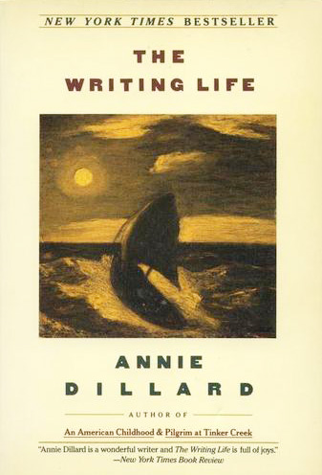
PRACTICE 4: IMITATING
With just a model sentence presented, plus a sample imitation of that model, students write their own imitations of the same model. Here, students imitate the model with no help other than a sample imitation.
Purpose: to practice using structures found in professionally written sentences to internalize those structures for use independently.
MODEL:
A golden female moth, a biggish one with a two-inch wingspread, flapped in the fire of the candle, drooped abdomen into the wet wax, stuck, flamed, and frazzled in a second.
Annie Dillard, “Death of a Moth”

Slide 22
Suggestions:
To simplify imitating the model sentence, have students first divide the model into sentence parts, and then imitate one part at a time.
■ To monitor the activity, have students recite just the first sentence part of their imitations of the model so that you and classmates can hear the structure of just that sentence part. Continue similarly for each of the remaining sentence parts. The effect of this activity is that students whose parts don’t match the model quickly realize the discrepancy and can revise.
■ Have students count off by threes (1-2-3, 1-2-3, and so forth). The number they say is the model they imitate. After students finish their imitations, have the sentences read aloud while the class guesses what model was imitated.
■ Assign a paragraph on a personal experience (sports victory, sickness, embarrassing moment, act of courage or kindness, and so on). Tell them to “bury” imitations of the three model sentences within the paragraph. Challenge them to make sure that all of the sentences in the paragraph—not just the three imitations— are high quality. Success means no one can guess what three sentences were imitations of the models because all of the sentences—not just the imitations—are well built.

Slide 23
Sample Imitation of Annie Dillard’s, “Death of a Moth”
Sample Imitation:
A green garter snake, a skittish one with a six-inch length, slid toward the foot of the tree, parted grass in the wet yard, stopped, sensed, and disappeared in a flash.

Slide 24
Practice 5: Exchanging
Given an author’s sentence containing the focus tool, students substitute their own alternate tool for the one in the author’s sentence. This practice, a collaboration between students and authors, with students adding a sentence part into the author’s sentence, encourages high-level replacements to maintain the high quality of the author’s sentence.
Purpose: to create an original focus tool that blends, in content and style, with an author’s sentence and to set a high standard for students’ use of that tool in their own writing.

Slide 25
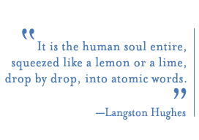
5. Exchanging
Author’s: A great many old people came and knelt around us and prayed, the women and men with work-gnarled hands.
Langston Hughes, The Big Sea
Yours: A great many old people came and knelt around us and prayed, the retirees and grandparents with lots of extra time.

Slide 26
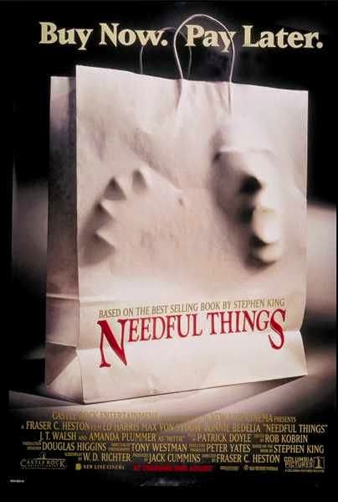
Practice 6: Expanding
The speech at her funeral was brief but warm about the life of Nettie Cobb, a woman who ^, a woman who ^.
Stephen King, Needful Things

Slide 27
Writing Through Reading by Cheryl Anastasio
http://www.yale.edu/ynhti/curriculum/units/1979/4/79.04.01.x.html
Using a poem of their choice, students will be asked to write a few stanzas in the same meter and tone. Light verse concerning an amusing idea expressed in an offhand manner provides the best model. Now you try it:

Slide 28
If You Like Pina Coladas https://www.youtube.com/watch?v=Eyaf1yMHx54
I was tired of my essay, we'd been together too long Like a worn-out recording of a favorite cliché So while it lay there taunting, I read the prompt in my head And in the paragraph margins, I annotated that-ish If you like Pina Coladas and getting a five on the thang If you're not a total dummy, if you have half-a-brain If you like staying up till midnight, in the need of caffeine We’ll write the essay you've looked for, write to me and escape I didn't think about my essay, I know that sounds kind of mean But me and my old paper had fallen into the same old dull routine So I wrote a new paper, and it was pretty rad And though I'm nobody's poet, I thought it wasn't half-bad Yes, I like Pina Coladas and getting a five on the thang I'm not much into English, I am in AP Lang I've got to be there by 7 (am) and read through all these essays At a place called the C Hall, where we'll plan our best days So I waited with high hopes, then I walked in the place I knew I’d pass in an instant, I knew the curve of my grade It was my time to prosper and I said, "O Thank you" And I laughed for a moment and I said, "I may be screwed" That you liked Pina Coladas and getting a five on the thang And the feel of exhaustion and the pace of my brain If you like breaking copyright at midnight, remember you’re a fake You're the paper I've looked for, come with me and escape If you like Pina Coladas and getting a five on the thang If you're not a total dummy, if you have half-a-brain If you like staying up till midnight, in the need of caffeine We’ll write the essay you've looked for, write to me and escape

Slide 29
Sympathy-Paul Dunbar
I KNOW what the caged bird feels, alas! When the sun is bright on the upland slopes; When the wind stirs soft through the springing grass, And the river flows like a stream of glass; When the first bird sings and the first bud opes, And the faint perfume from its chalice steals — I know what the caged bird feels!
I know why the caged bird beats his wing Till its blood is red on the cruel bars; For he must fly back to his perch and cling When he fain would be on the bough a-swing; And a pain still throbs in the old, old scars And they pulse again with a keener sting — I know why he beats his wing!
I know why the caged bird sings, ah me, When his wing is bruised and his bosom sore,— When he beats his bars and he would be free; It is not a carol of joy or glee, But a prayer that he sends from his heart's deep core, But a plea, that upward to Heaven he flings — I know why the caged bird sings!

Slide 30
Thank you
Please contact me at:
pbelmont@bisd.us
With any questions, ideas or suggestions

